Slide 1

Synthesizing Datalog Programs
using Numerical Relaxation
Xujie Si · Mukund Raghothaman · Kihong Heo · Mayur Naik
University of Pennsylvania

Slide 2


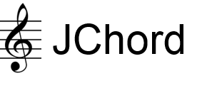

Background
Declarative logical rules are widely used …
Datalog $≈$First-order logical rules + Least fixed-point semantic
SociaLite
BigDatalog
Big Data Analytics
Networking
Program Analysis

Slide 3
The Problem & Challenges
Synthesizing logical rules from relational data
Inductive logic programming
Program Synthesis
Soundness
Recursion
FOIL
(Quinlan, 1990)
Constraint-based synthesis (Albarghouthi et al, 2017)
Predicate invention
Progol, Metagol
(Muggleton, 1995, 2015)
Syntax-guided synthesis (Si et al, 2018)
Resilience to noise
ad-hoc heuristics
“greedy”
Scalability
systematic search
“discrete combinatorial”

Slide 4
Central Question
Can numerical approaches be used for synthesis of logic programs?
Notes:
Gradient-based, stochastic approaches have achieve dramatic successes in deep learning …

Slide 5

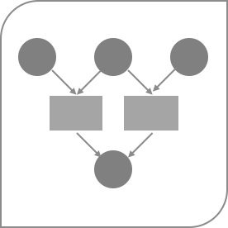
Outline
Rule Selection
Datalog Relaxation
Optimization
Evaluation

Slide 6
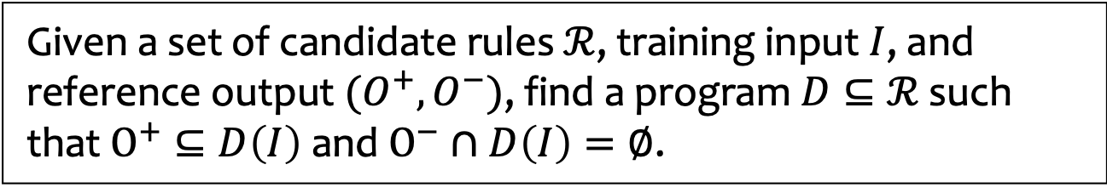
Rule Selection Problem
Given a set of candidate rules $ℛ$, training input $I$, and reference output $(O^{+},O^{−})$, find a program $D⊆ℛ$ such that $O^{+}⊆D\left(I\right)$ and $O^{−}∩D\left(I\right)=∅$.
NP-Hard
Key idea
Associate each rule with a weight
Turn combinatorial search into continuous optimization
Popular in math opt.
LP relaxation,
SDP relaxation, etc.
Rule generation
Syntax-guided approach (Alur et al., 2013)
Inductive bias, e.g. meta-rules (Muggleton et al., 2015)
Meta-rule augmentation (Si et al., 2018)
Notes:
Where do these candidate rules come from?

Slide 7

Rule Selection Problem
Rule generation approaches
Syntax-guided approach
Inductive bias, e.g. meta-rules
Meta-rule augmentation
path (x, y) | :- | edge (x, y).
path (x, x) | :- | edge (x, y).
path (x, z) | :- | edge (x, y), | path (y, z).
path (x, y) | :- | path (y, x).
 | …
NP-Hard
O⁺
I
O⁻⁻

Slide 8
Key idea
Inspired by the popular paradigm in mathematical optimizations
like LP relaxation, SDP relaxation, etc.
Associate each rule with a weight
Therefore each tuple will get a weight (depending on how it is derived)
Turn combinatorial search into continuous optimization
Recover the desired logic program from the optimized weights
Notes:
First time we mention tuple, explain it (e.g. derived fact, Boolean => numerical)

Slide 9

Outline
Rule Selection
Datalog Relaxation
Optimization
Evaluation

Slide 10
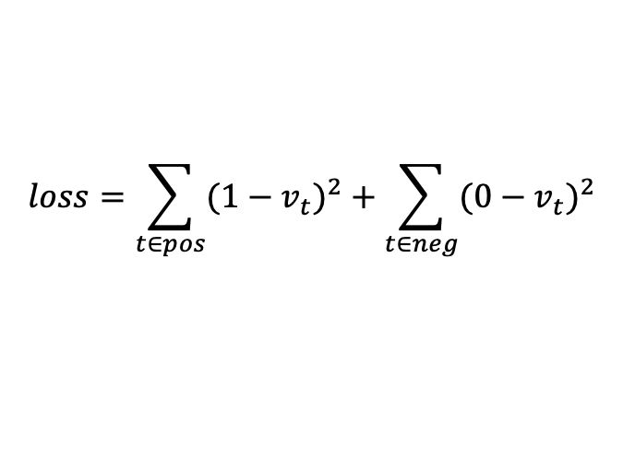

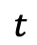
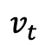
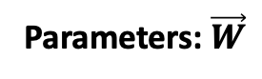
Datalog relaxation
Combinatorial Search ➔ Continuous Optimization
Parameters: $\vec{W}$
path (x, y) | :- | edge (x, y).
path (x, z) | :- | edge (x, y), | path (y, z).
path (x, x) | :- | edge (x, y).
path (x, y) | :- | path (y, x).
Find $\vec{W}$ which minimizes the loss:
0.7
0.9
0.1
0.3
$$loss=\sum_{t∈pos}{{(1−v_{t})}^{2}}+\sum_{t∈neg}{{(0−v_{t})}^{2}}$$
edge(1, 2) | edge(2, 3)
1.0 | 1.0
$$t$$
path(1, 2) | path(2, 3) | path(1, 3) | path(1, 1) | path(2, 1) | …
0.7 | 0.7 | 0.63 | 0.1 | 0.21 | …
Question: how do we compute this?
$$v_{t}$$
1 | 1 | 1 | 0 | 0 | …
Notes:
Continuous optimization: always treat all rules as one giant program
Advatanges:
Noise
Parallel (Las Vegas algorithm)

Slide 11
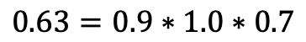
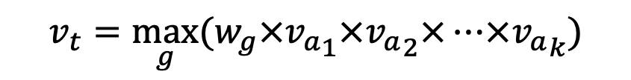
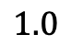
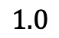
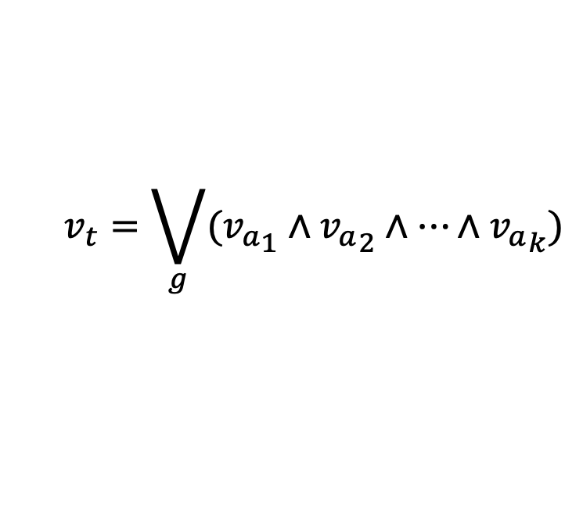
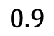
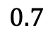
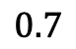
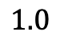
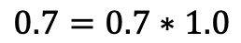
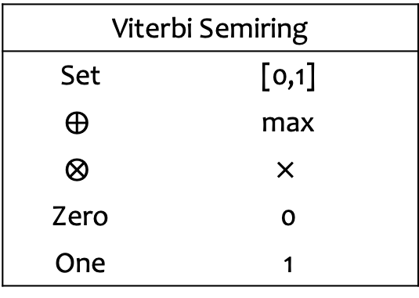

Datalog relaxation
r1:
0.7 | path (x, y) | :- | edge (x, y).
0.9 | path (x, z) | :- | edge (x, y), | path (y, z).
$$1.0$$
edge(2,3)
r2:
r1
$$0.7$$
$$1.0$$
edge(1,2)
path(2,3)
$$0.7=0.7∗1.0$$
Viterbi Semiring
Set | [0,1]
$$⨁$$ | max
$$⨂$$ | $$×$$
Zero | 0
One | 1
$$1.0$$
edge(1,3)
r2
$$0.9$$
$$0.7$$
r1
path(1,3)
$$0.63=0.9∗1.0∗0.7$$
$$0.7=max⁡\{0.7, 0.63\}$$
$$v_{t}=\bigvee_{g}{({v_{a}}_{1}∧{v_{a}}_{2}∧…∧{v_{a}}_{k})}$$
$$v_{t}=\max_{g}{(w_{g}×{v_{a}}_{1}×{v_{a}}_{2}×…×{v_{a}}_{k})}$$
Notes:
The score does NOT mean probability / likelihood
Least-fixed point semantics < === > Viterbi semi-ring

Slide 12
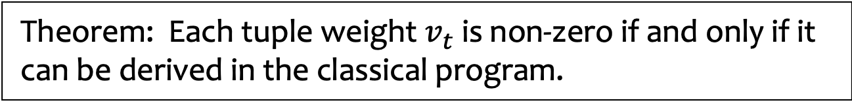
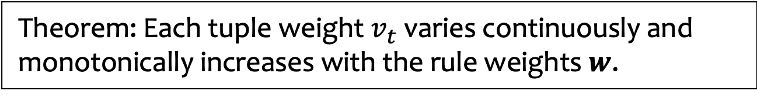
Connections to classical Datalog
Theorem: Each tuple weight $v_{t}$ varies continuously and monotonically increases with the rule weights $w$.
The loss surface is still NOT monotonic.
Theorem: Each tuple weight $v_{t}$ is non-zero if and only if it can be derived in the classical program.
This enables us to recover classical program.
Easy to modify existing Datalog solvers with only O(1) overhead.

Slide 13
Outline
Rule Selection
Datalog Relaxation
Optimization
Evaluation

Slide 14
Optimization
Newton-Raphson method + Periodic MCMC sampling
Focus on the exact program synthesis where zero loss is achievable
Periodic MCMC helps to escape local minimum
Early termination
Based on a sound separation condition
Leverage parallelization
Our approach is a type of Las Vegas algorithm

Slide 15
Outline
Rule Selection
Datalog Relaxation
Optimization
Evaluation

Slide 16
Evaluation
https://github.com/petablox/difflog
Difflog: a prototype implementation in Scala
Baseline
ALPS, the state-of-the-art tool in C++
34 benchmark problems in three categories
Knowledge discovery (8 tasks, up to 4 rules)
Relational queries (15 tasks, up to 4 rules)
Program analysis (11 tasks, up to 10 rules)
Setup
Run in 32 parallel processes

Slide 17

Difflog vs ALPS
Converges to the global optimal quickly
Orders of magnitude faster
Search space is $2^{\#rules}$
benchmark |  | #relations | #candidate rules | Difflog #iterations (time in sec) |  | ALPS (time in sec)
Program Analysis | polysite | 6 | 552 | 17 | 27 | 84
 | downcast | 9 | 1267 | 5 | 30 | 1646
 | rv-check | 5 | 335 | 1205 | 22 | 195
 | andersen | 5 | 175 | 1 | 4 | 27
 | 1-call-site | 9 | 173 | 4 | 4 | 106
 | 2-call-site | 9 | 122 | 25 | 53 | 676
 | 1-object | 11 | 46 | 3 | 3 | 345
 | 1-type | 12 | 70 | 3 | 4 | 13
 | escape | 10 | 140 | 2 | 1 | 5
 | modref | 13 | 129 | 1 | 1 | 2836

Slide 18
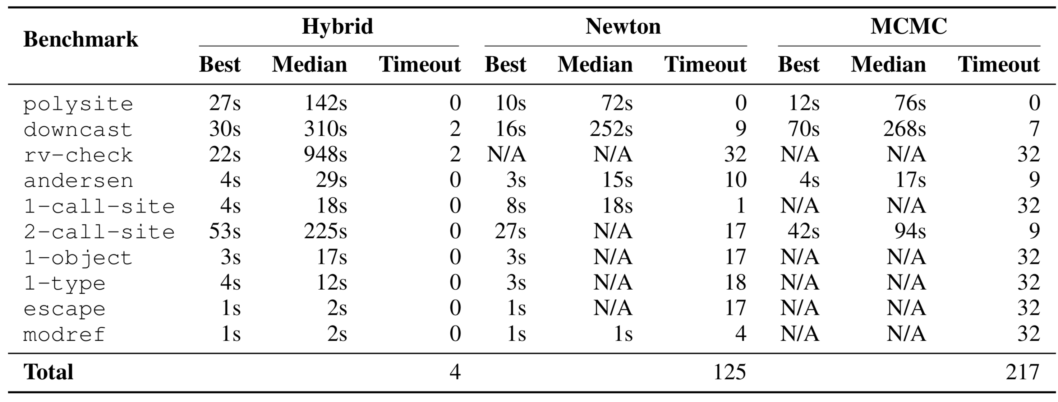
Successfully synthesize all tasks
Hybrid approach is more effective and efficient
Almost no timeout

Slide 19
Conclusion
Numerical approaches significantly improve synthesis of logic programs
Thank you!
To learn more details, please come to our poster #5666!

